Slide 2
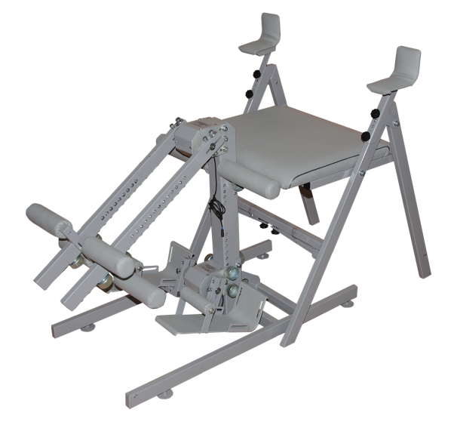
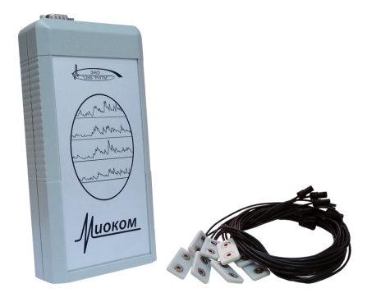
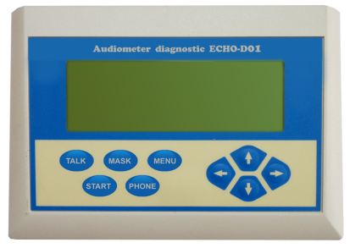
My name is Yury Starovoytov. I represent the company RITM OKB ZAO. I am its Chief Executive Officer.
Our company OKB RITM has been operating for over 30 years. It is developing and manufacturing various medical equipment and devices: audiometers, stabilizing platforms, silocoms, miocoms and many more.
Miocom
Stabilizing platform
Silocom
Audiometer

Slide 3
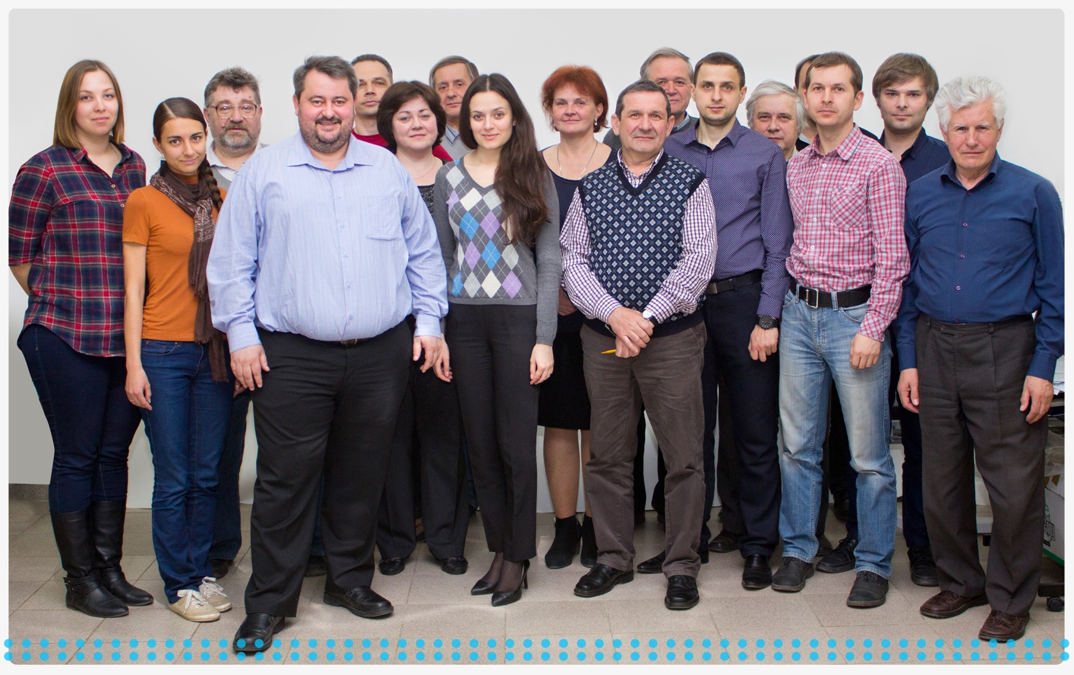
OKB has huge scientific and technical potential. Over 50 engineers and developers are currently working for us.
One of the main areas of our work is development, manufacturing and distribution of the medical devices SCENAR, which is familiar to many of you.
Through my medical practice I became convinced that this device is unique.

Slide 4
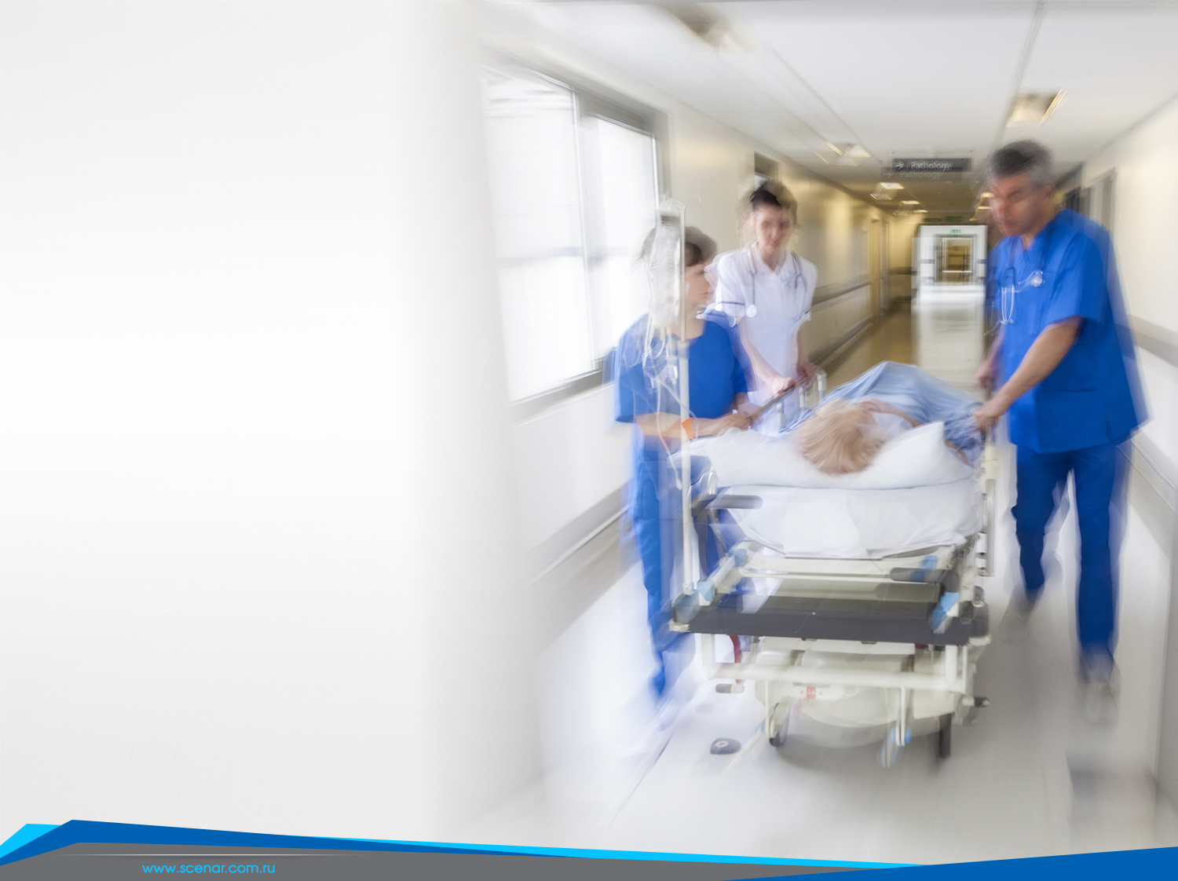
An elderly woman was in a very bad condition
diabetes,
dystrophic dysfunctions,
loss of vision,
polyneuropathy
As a doctor, I followed all the recommendations of traditional medicine, but nevertheless there was no improvement. When I saw that even the most advanced contemporary medicine was not always able to save a person I decided to look for a better way to help her.

Slide 5
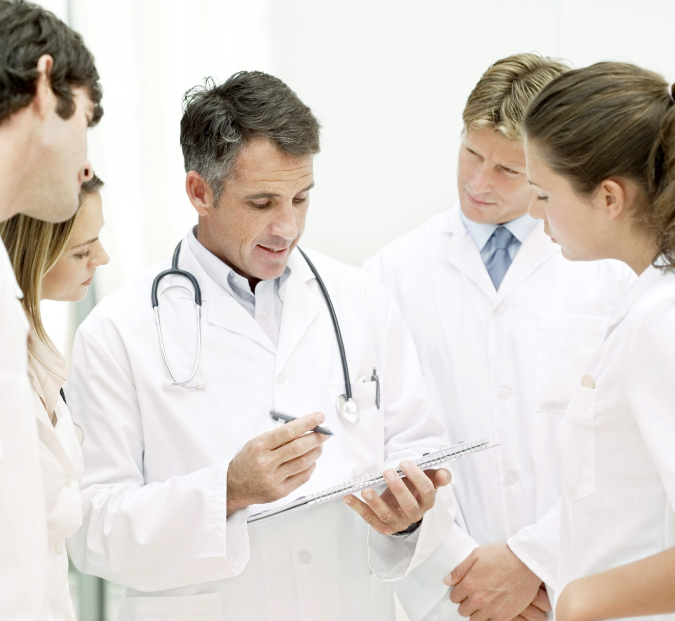
I asked my colleagues for advice

Slide 6
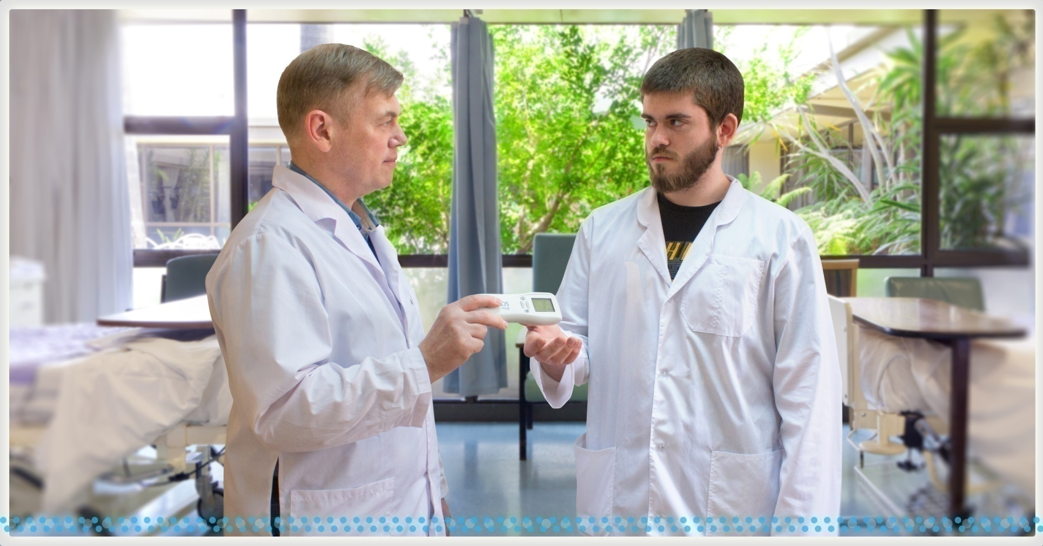
One of the doctors put SCENAR into my hands saying
“Try this technology”

Slide 7
In a week the first positive changes appeared.
I got very interested in this method and I continued treating her with SCENAR.
In three months I achieved great results: blood sugar stabilized to the normal level, vision improved, innervation and trophic of tissue were restored.
This changed my outlook on treatment options. For over 16 years I have been preferring SCENAR treatment.

Slide 8
«If today I go outside without a SCENAR,
I feel as if I were
James Bond without his gun»

Slide 9
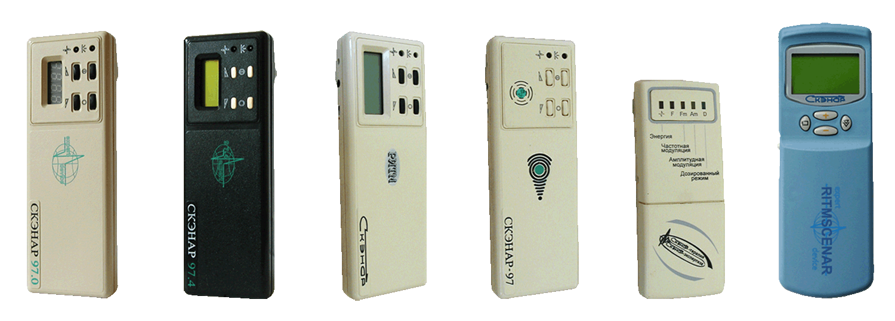
SCENAR
is the most unique device to appeared on the turn of the 20th and 21st centuries
It was created by engineers and doctors together. Every change in the SCENAR signal was tested by doctors in practice; for years its treatment effect was being brought to perfection working on the patients. The uniqueness of this device is related to special approach to treatment.

Slide 10
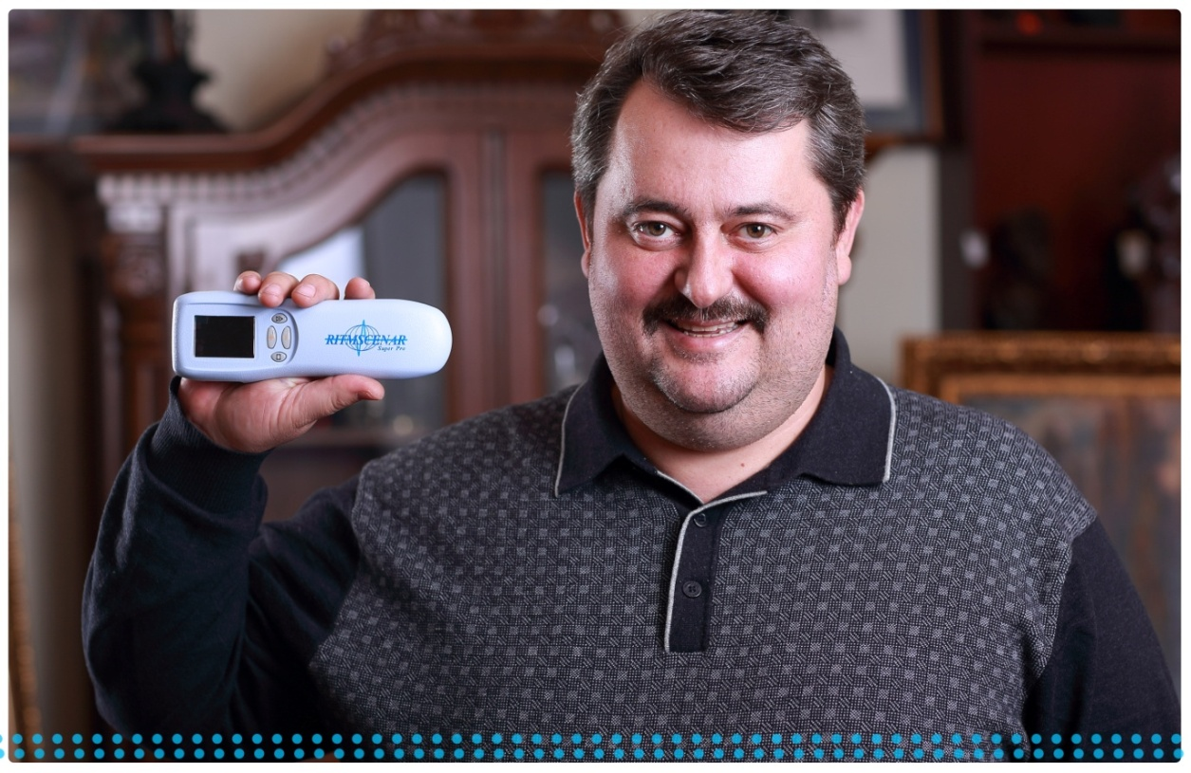
SCENAR can conduct a dialogue with the organism of the patient.
The device affects the skin, registers response reactions and if the organism responds with changes, SCENAR immediately changes the parameters of its impact.
The device, the technology and its application were created at the same time and are inseparable. That is why all attempts to simply copy our device would not entirely repeat those terrific results that SCENAR produces.
SCENAR technology is unique.
All the manufacturers of its analogues claim that their devices are the same as SCENAR, but “better”. But up to now they cannot repeat the same effectiveness of the results in treating various illnesses.

Slide 11
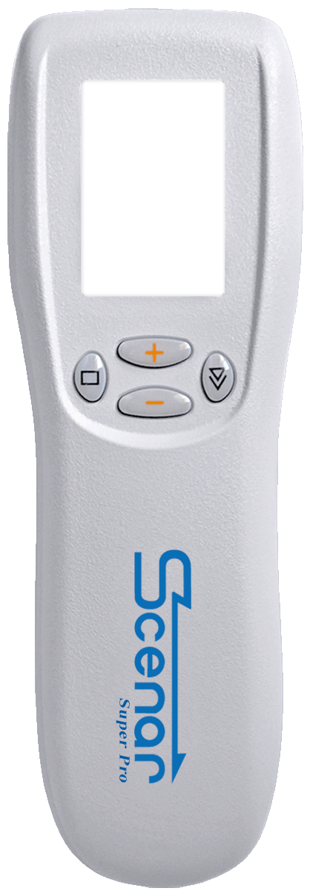
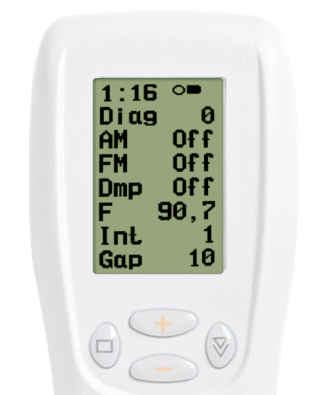
OKB tried to create a universal device that would be the most effective and at the same time simple to use by SCENAR practitioners for treating various problems.
SCENAR can be used when treating both acute and chronic conditions; both in sports and in cosmetology.
Simple to use. Beginning specialists can immediately start achieving good results while step by step studying methodology. This allows them to better master SCENAR technology and become highly qualified specialists.
With this purpose in mind, OKB constantly continues updating and improving SCENAR devices.
SCENAR
Super Pro
acute pain (state)
sports
chronic pain (state)
reabilitation
cosmetology
trauma

Slide 12
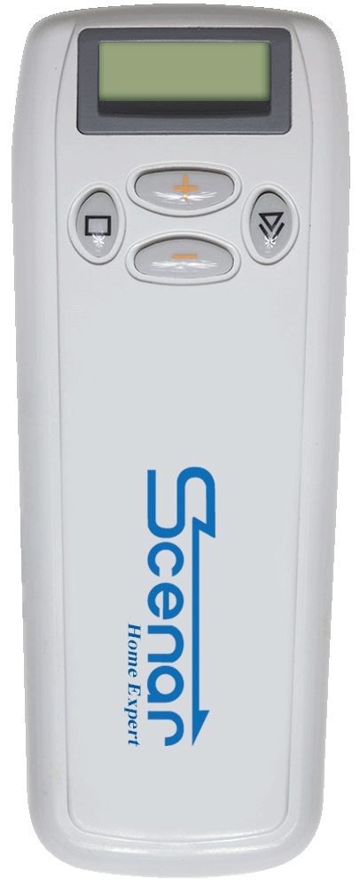
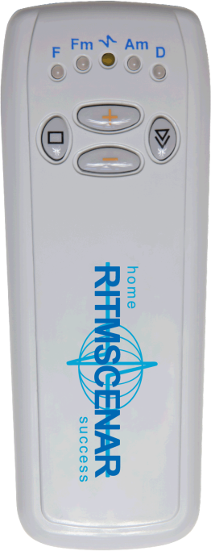
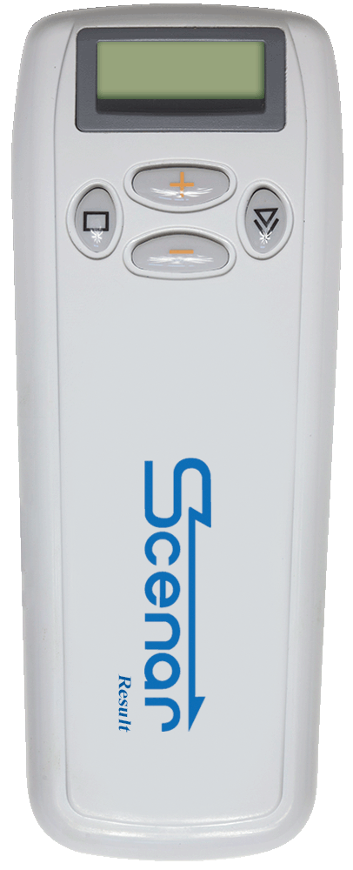
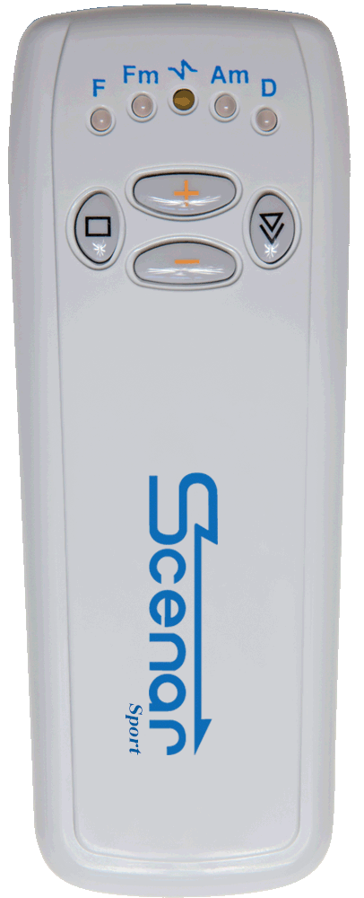
Certain improvements were made on home use devices.
We have improved diagnostics of the most optimal zones. Those are devices Home Expert with a screen and Home Success without a screen. It has two kinds of diagnostics that allow us to locate the best zone to work on.
This is the group of devices CHANS -01 with added diagnostics.
SCENAR Expert
SCENAR Home Success
SCENAR Result
SCENAR Sport Plus

Slide 13
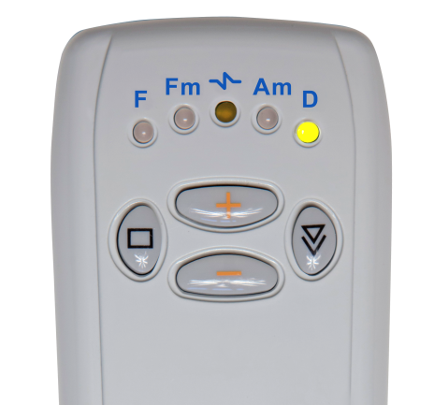
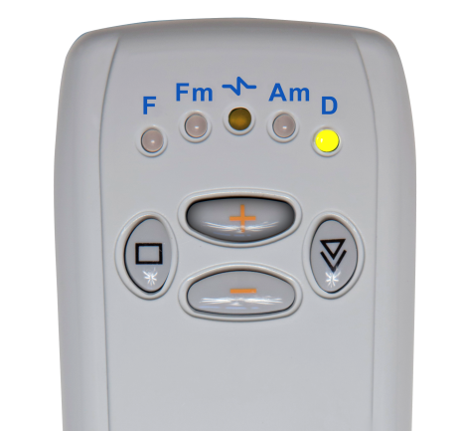
Diagnostic 1
When the light D goes on, we turn on plus, one time and the regime D-1 turns on (we call it diagnostic 1) this regime D-1 allows us to quickly determine and choose the optimal place for medical application according to the number of the lights that are on.

Slide 14
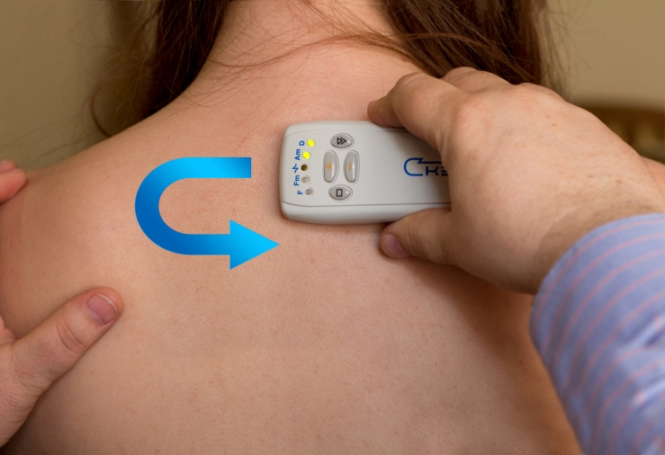
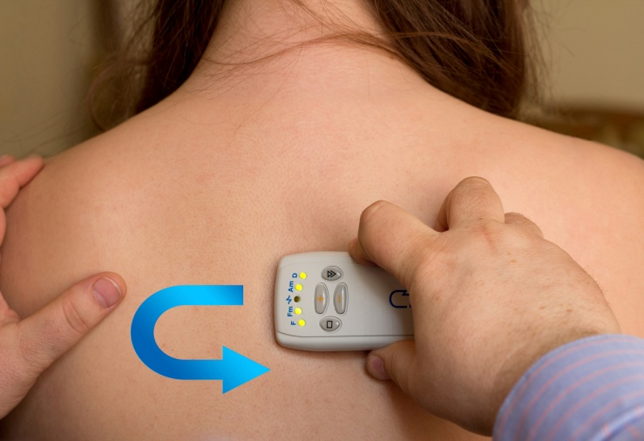
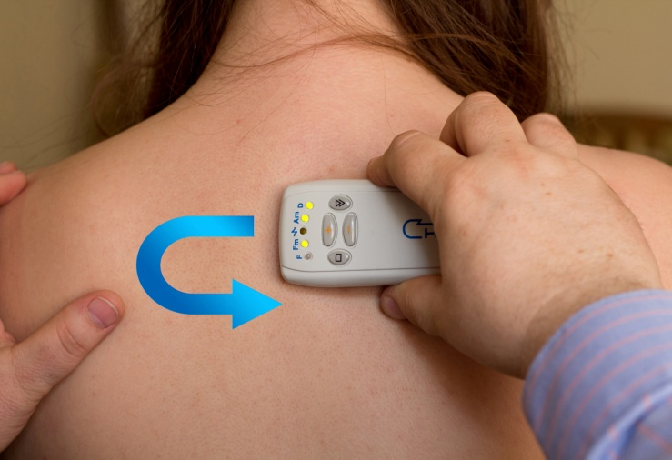
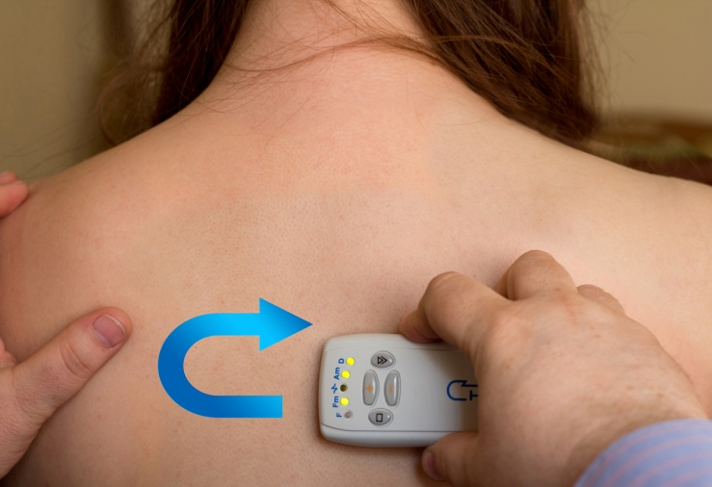
Depending on the place, one to four lights may go on, the more optimal the zone, the more lights on the device will be on.
1
3
2
4

Slide 15
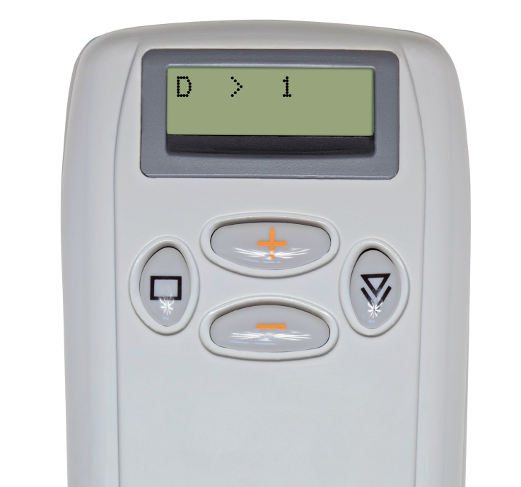
On the device with the screen, information will be shown in numbers 1 through 4

Slide 16
Diagnostic 2
Press the right button until the light D switches on. Then we press button “+” until the double sound goes on or D-2 (diagnostic 2) appears on the screen.
This diagnostic is used when the device is slid on the skin. It allows us to locate active areas (zones of small asymmetry.)

Slide 17
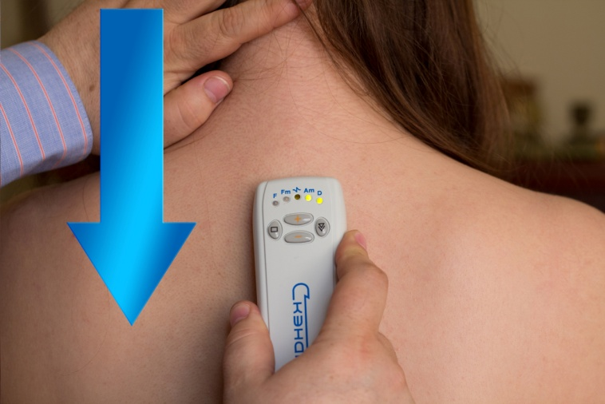
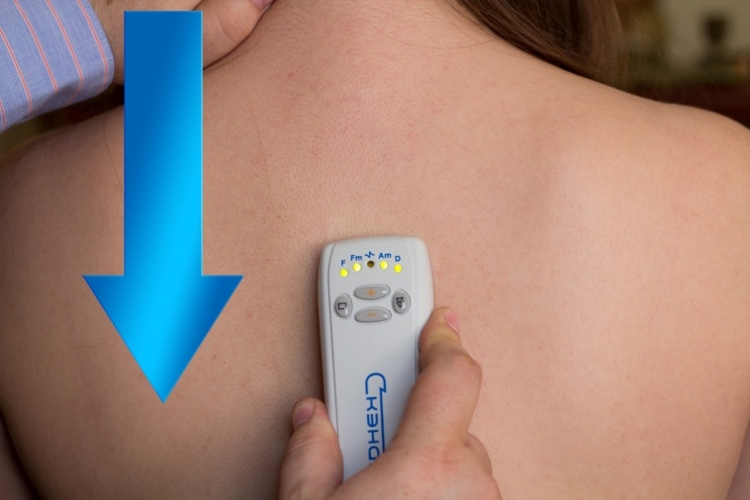
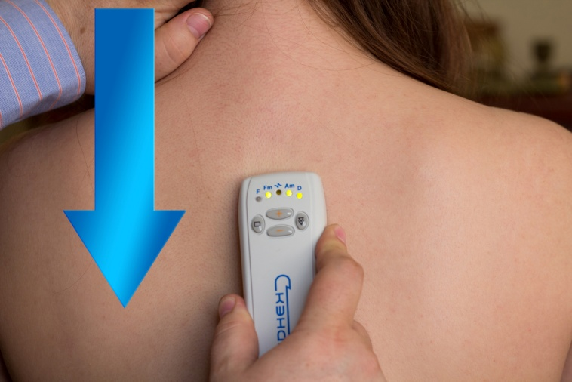
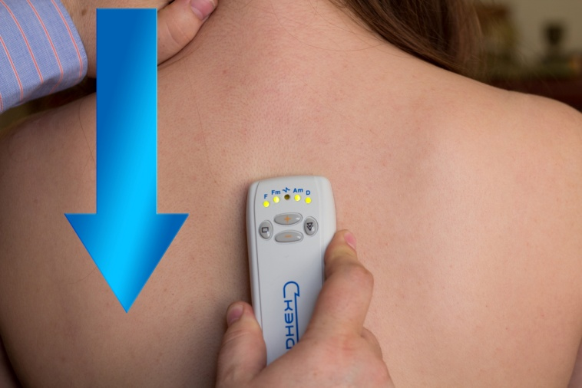
Where the problem is more active, more lights switch on the skin at once.
It allows us to quickly find an optimal zone to work on.
1
3
2
4

Slide 18
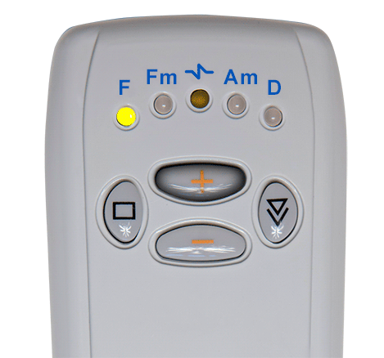
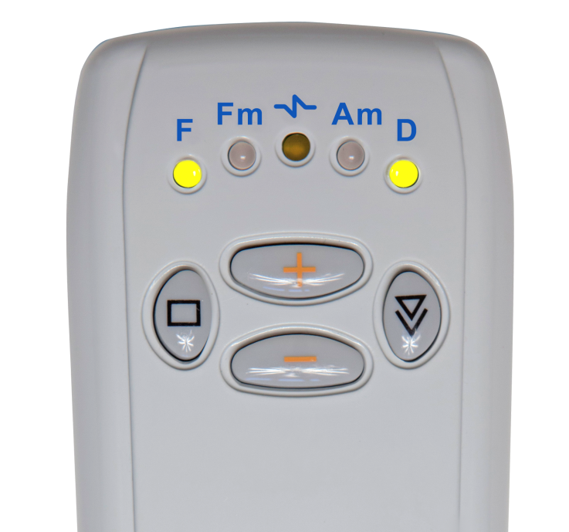
1st pre-set
is the automatic switch of the operating mode when there is an acute condition
Switching is done by a short press of the right button.
After another flashing of all lights, we press + and at the same time lights D and F switch.
In this mode the number of impulses in the set and the distance between them are adjusted and modified automatically according to the reaction of the organism.

Slide 19
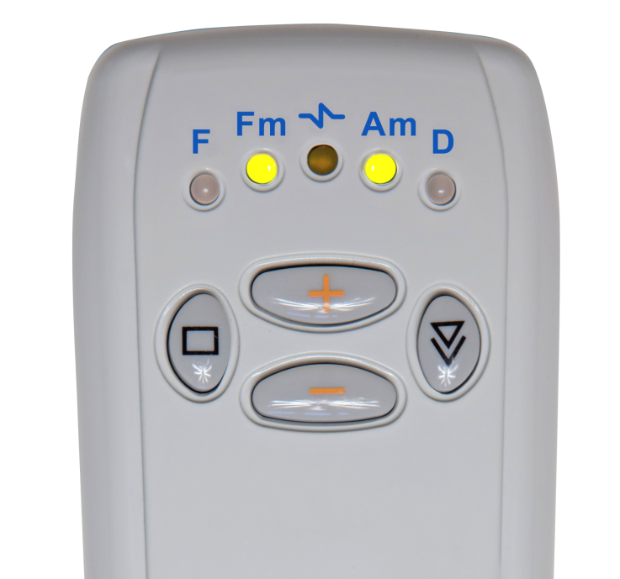
2nd pre-set
is designed to work with chronic conditions, when there is no effect and no improvement
This mode will simplify the work for the users of SCENAR in difficult situations.

Slide 20
Devices Home Result and SCENAR Sport Plus – have usual CHANSE diagnostic which previously was CHANS-SCENAR and, in addition, two pre-sets.
In the second half of 2014 we will start mass manufacturing of all the above mentioned devices.
For those who are interested, after the presentation I am ready to demonstrate how some of these devices work.
Our most important goal is making all the nations healthier and helping people to restore and preserve their health using the safest and most effective methods.
SCENAR is a clinic and a pharmacy and an emergency room in a person’s pocket.

Slide 21
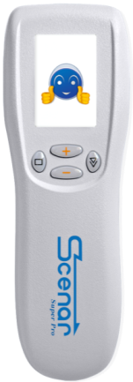
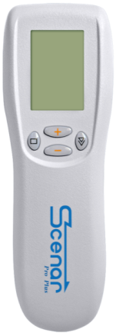
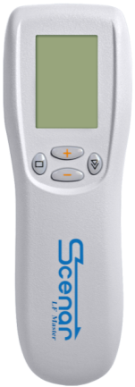
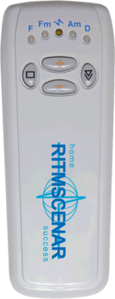
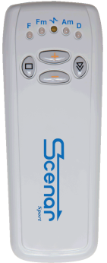
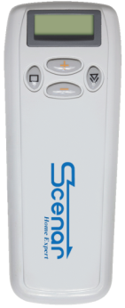
Our goal is for SCENAR to enter each and every home, each and every family. To make it possible, we want to create an effective distribution channel for our device and our technology.
SCENAR Super Pro
SCENAR LF Master
SCENAR Home Success
SCENAR Sport Plus
SCENAR Pro Plus
SCENAR Expert
SCENAR Result

Slide 22
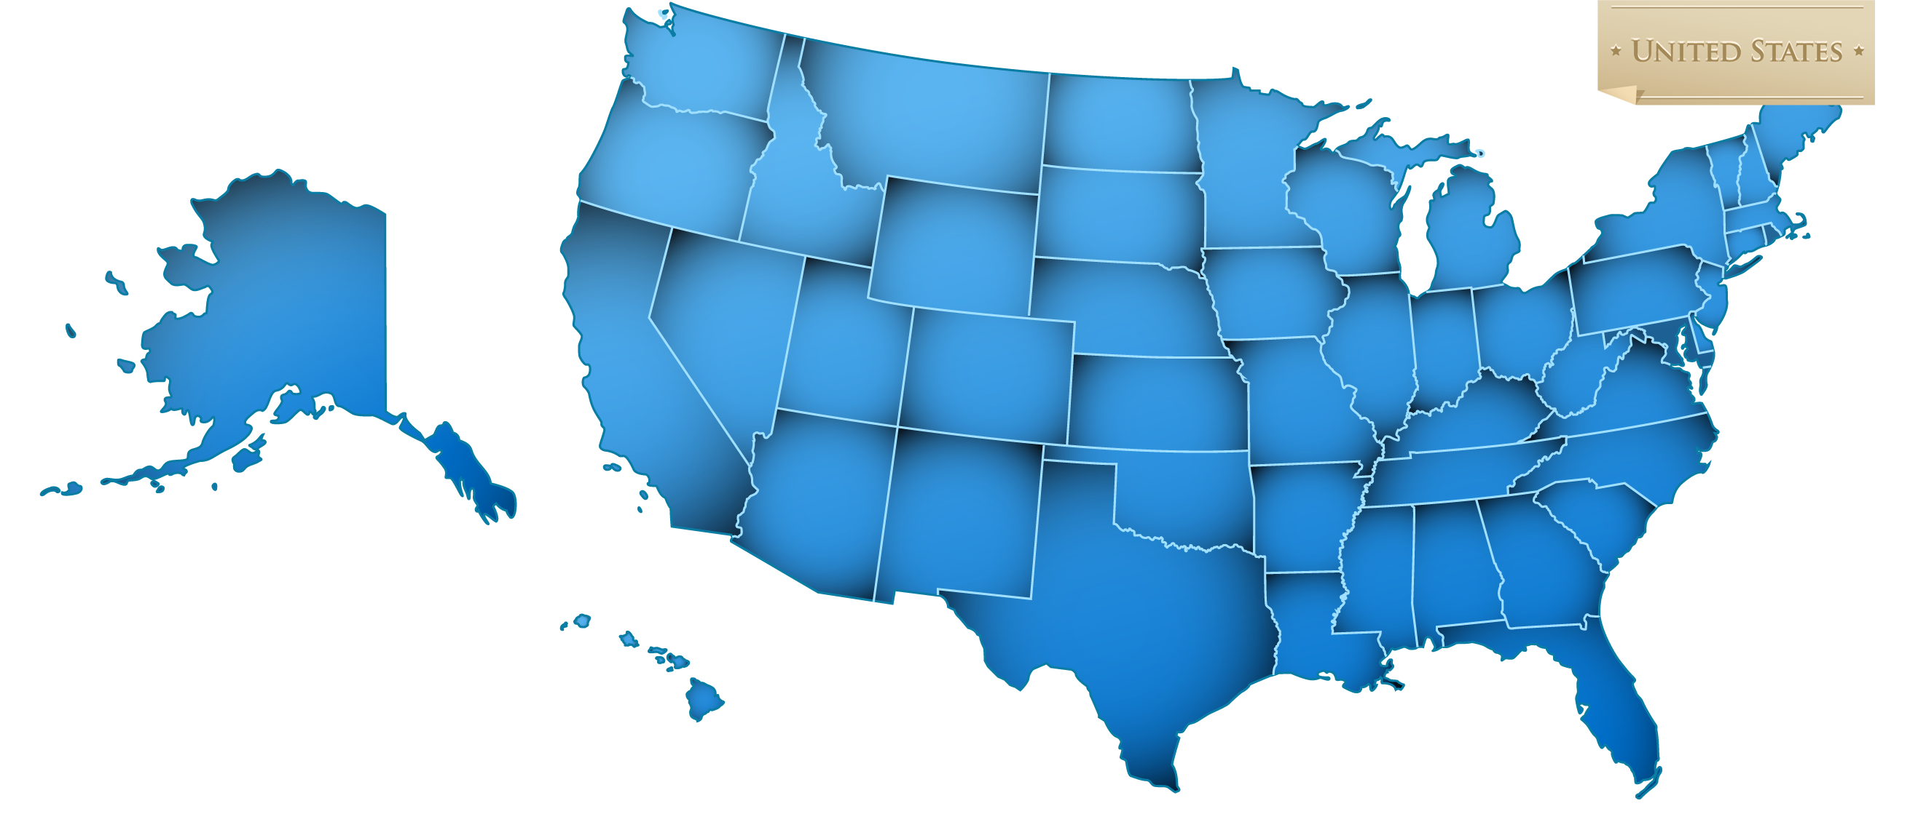
What can we offer?

Slide 23
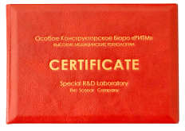
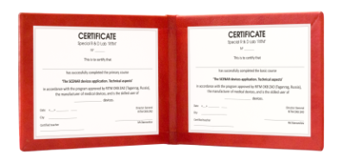
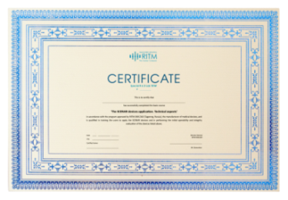
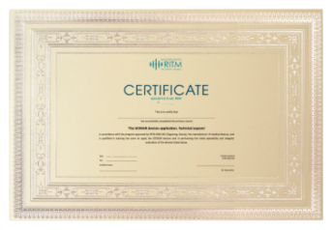
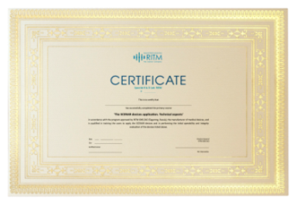
Educational system
Various certificates on the completion of training will be issued for educators, for dealers and for medical practitioners.
Those who attend the basic course will receive certificates of red color.
Dealers
Medical practitioners

Slide 24
By September of this year educational programs of all levels have been prepared and are being adapted for the users on the American market.
Those who are already conducting trainings and have their practice will be interviewed and will receive a renewed certificate.
Currently a new US-based company RITMSCENAR OKB Inc. has been created.
It is engaged in distribution, education and, in the future, manufacturing of the devices in the American market.

Slide 25
I hope that together we will be able to achieve the main, noble mission – to help people restore and preserve health, their own and their children’s’.
Through our joint efforts SCENAR should become a friend and a reliable partner in every family.

